Slide 1
Sprint 4
Final Presentation
SR
Scan Unlock Return
SwiftRide
WeChat Mini Program
Campus shared e-scooter system with WeChat Mini Program, Express API, MySQL database, and management web dashboard.
Node + Express API
Software Engineering Course
Group 1
MySQL / MariaDB
Team Members: SwiftRide Development Team
Management Web
May 2026

Slide 2
Catalogue
01
Project Introduction
08
Testing Evidence
02
Sprint 4 Objectives
09
Final Demo Flow
03
Sprint 4 Achievement Checklist
10
Process Management
04
Main User Functions
11
Teamwork and Communication
05
Admin / Management Functions
12
Technical Challenges and Solutions
06
Backend and Database
13
Project Summary
07
Code and Version Control
14
Thank You

Slide 3
01
Project Introduction
Project Introduction
What SwiftRide is and who it serves
System Purpose
User Roles
Technology Stack
A campus shared e-scooter rental system.
Supports scan-to-rent, booking, payment simulation, return checking, and issue reporting.
Connects customer-side workflows to an operator dashboard and MySQL data.
Rider
Vue 3 + uni-app
Register, book, ride, return
WeChat Mini Program
Admin
Express.js REST API
Monitor users, scooters, bookings
MySQL / MariaDB
Operator
Element Plus Management Web
Handle faults and deployment

Slide 4
02
Sprint 4 Objectives
Sprint 4 Objectives
Final integration and delivery goals
Customer-side goals
Admin-side goals
Backend/database goals
Final delivery goals
Stable WeChat Mini Program build
Modular profile page
Local data sync entry
Booking and issue workflows
Browser management dashboard
Editable scooter and issue status
Live backend connection state
Operational metrics overview
Express routes for core resources
MySQL schema and seed data
/api/sync/local upsert endpoint
Health and dashboard APIs
Integrated package and root project config
Build verification
Classroom demo flow
Evidence-based final PPT

Slide 5
03
Achievement Checklist
Sprint 4 Achievement Checklist
Backlog items mapped to implementation evidence
Backlog Item | Category | Status | Evidence
WeChat customer client builds successfully | Frontend | Completed | build:mp-weixin
Modular profile/account page | Frontend | Completed | profile/index.vue
Local data sync to database | Integration | Completed | /api/sync/local
Management dashboard connected to backend | Admin Web | Tested | 5176 screenshot
Scooter / booking / issue APIs | Backend | Completed | routes + API JSON
MySQL schema and seed data | Database | Completed | init_swiftride.sql
Integrated package for partner handoff | Delivery | Completed | root project.config.json
Final classroom demo flow | Presentation | In Progress | PPT + live demo
Status values: Completed / In Progress / Tested

Slide 6
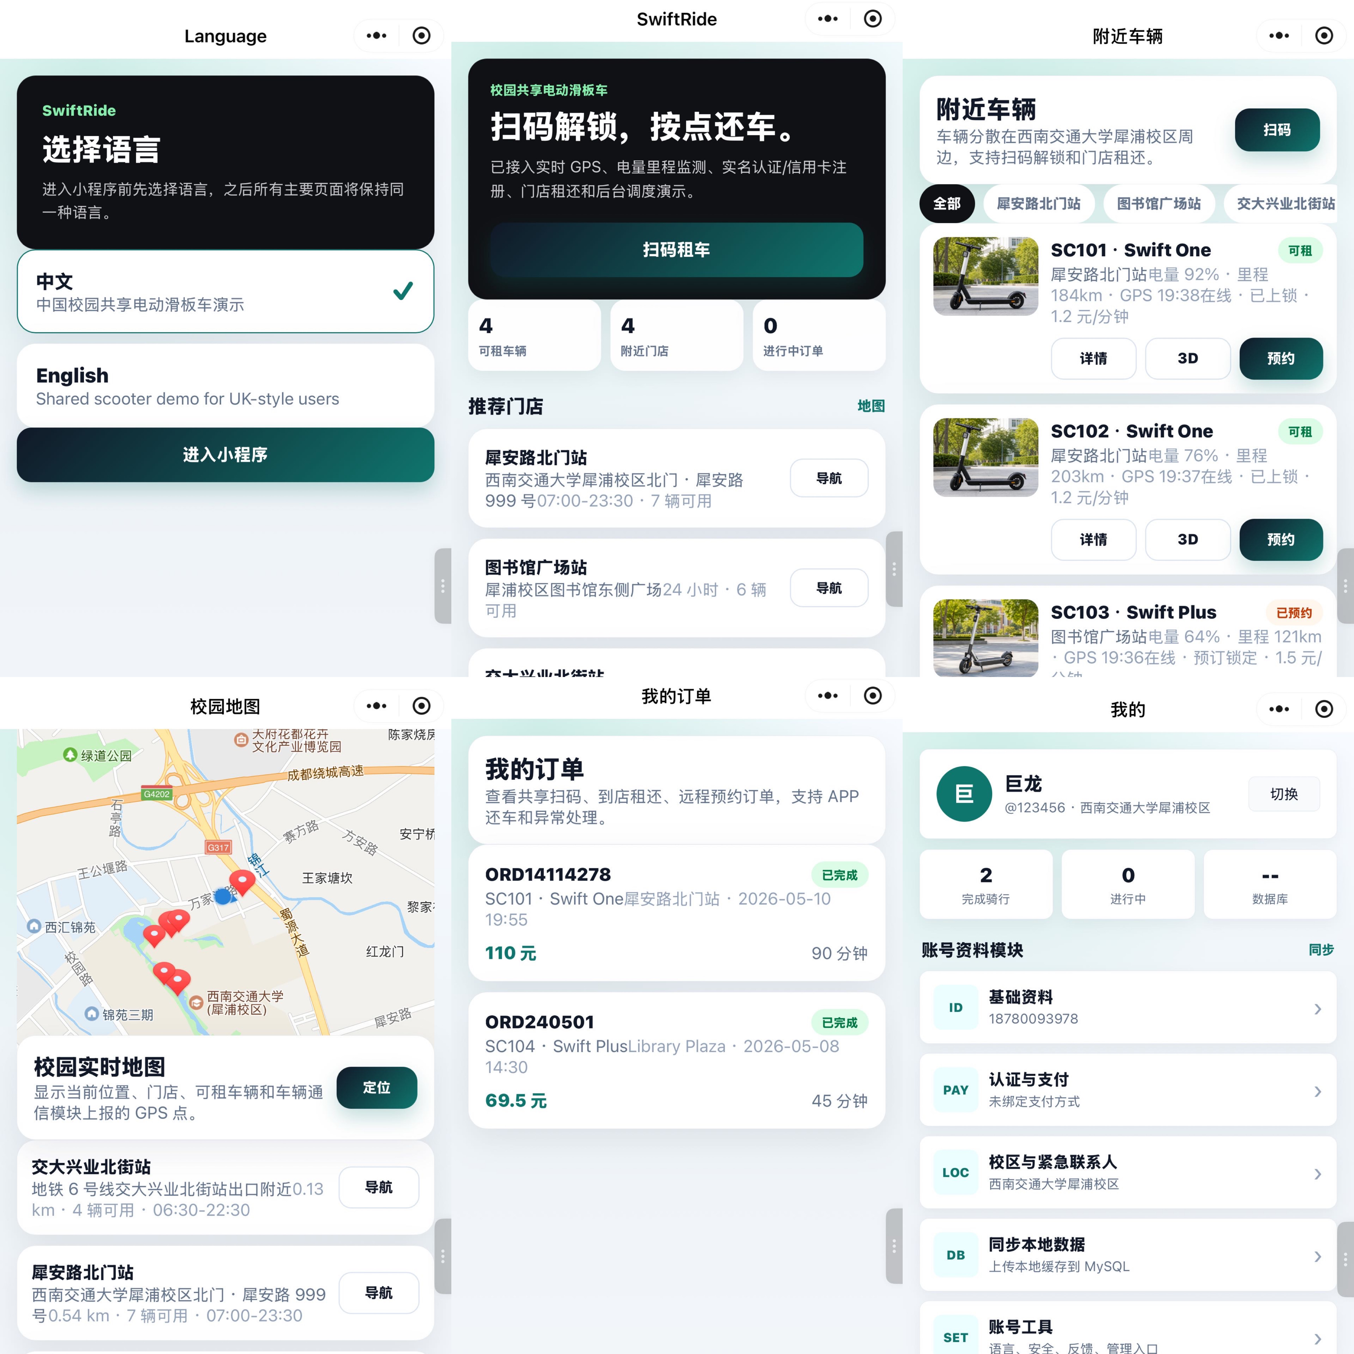
04
Main User Functions
Main User Functions
Customer workflows implemented in the Mini Program
Language & Home
Scooter Booking
Language selection, overview metrics, recommended stores, active order entry.
Model selection, rental mode, insurance, payment method, safety confirmation.
Orders & Return
Profile Modules
Order history, return-zone check, battery/mileage fee calculation, cancellation.
Basic profile, verification/payment, campus contact, local-to-MySQL sync.
WeChat DevTools Mini Program Screenshot
Insert live home/profile/booking screenshot after opening DevTools

Slide 7
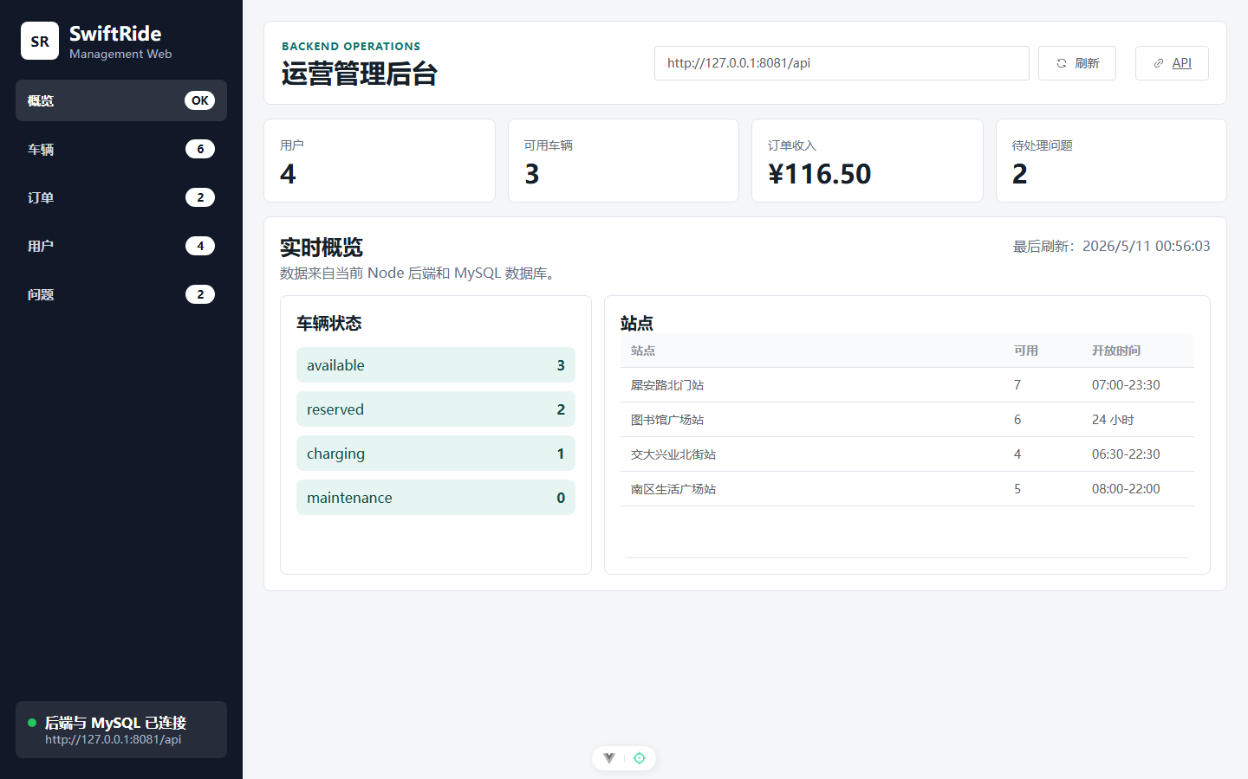
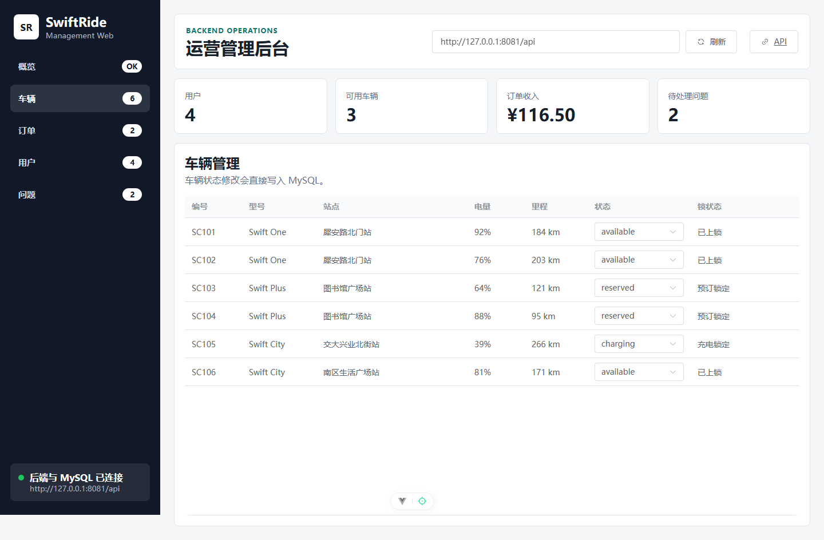
05
Admin / Management
Admin / Management Functions
Real management dashboard connected to the backend API
Function | Evidence
Dashboard metrics | users, available scooters, revenue, open issues
Scooter management | status selector writes to MySQL via PATCH API
Bookings table | orders from Mini Program and backend
Issue handling | priority/status update workflow

Slide 8
06
Backend and Database
Backend and Database
Express API and MySQL schema
Frontend
Backend
Database
WeChat Mini Program
Management Web
Express.js REST API
Auth, scooters, bookings, issues, sync
MySQL / MariaDB
users, stores, scooters, bookings, issues
Route group | Purpose
/api/auth | login and registration
/api/scooters | list, detail, status update
/api/bookings | create, list, update order lifecycle
/api/issues | report and manage faults
/api/admin/dashboard | dashboard aggregate data
/api/sync/local | sync WeChat local cache to MySQL
Tables | Key responsibility
users | customer/admin accounts and verification
stores / return_zones | locations and return radius
scooters | fleet state and telemetry
bookings | rental order lifecycle
issues | fault reports and handling

Slide 9
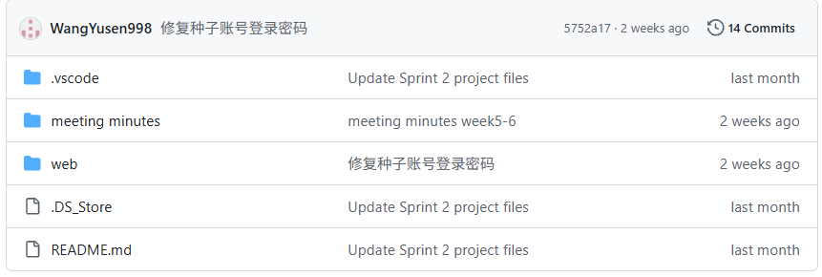
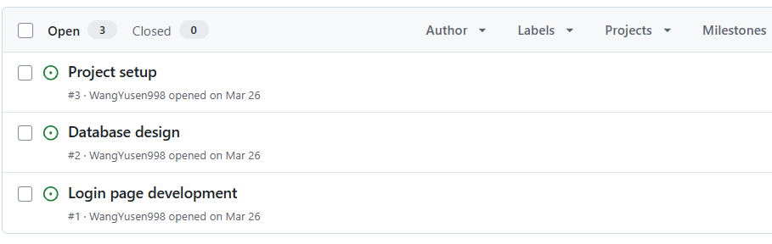
07
Code and Version Control
Code and Version Control
Repository structure and evidence to present
Area | Local evidence
backend | Express routes, MySQL config, scripts/start-db.ps1, scripts/init-db.ps1
customer-miniprogram | Vue/uni-app pages, build output, root project config
management-web | Vue 3 + Element Plus dashboard
docs | app/web split plan and package README
GitHub Repository Screenshot
Insert repo overview screenshot
Issues / PR Screenshot
Insert issue tracker or PR evidence
Local package does not include .git metadata; GitHub screenshots should be added before submission.

Slide 10
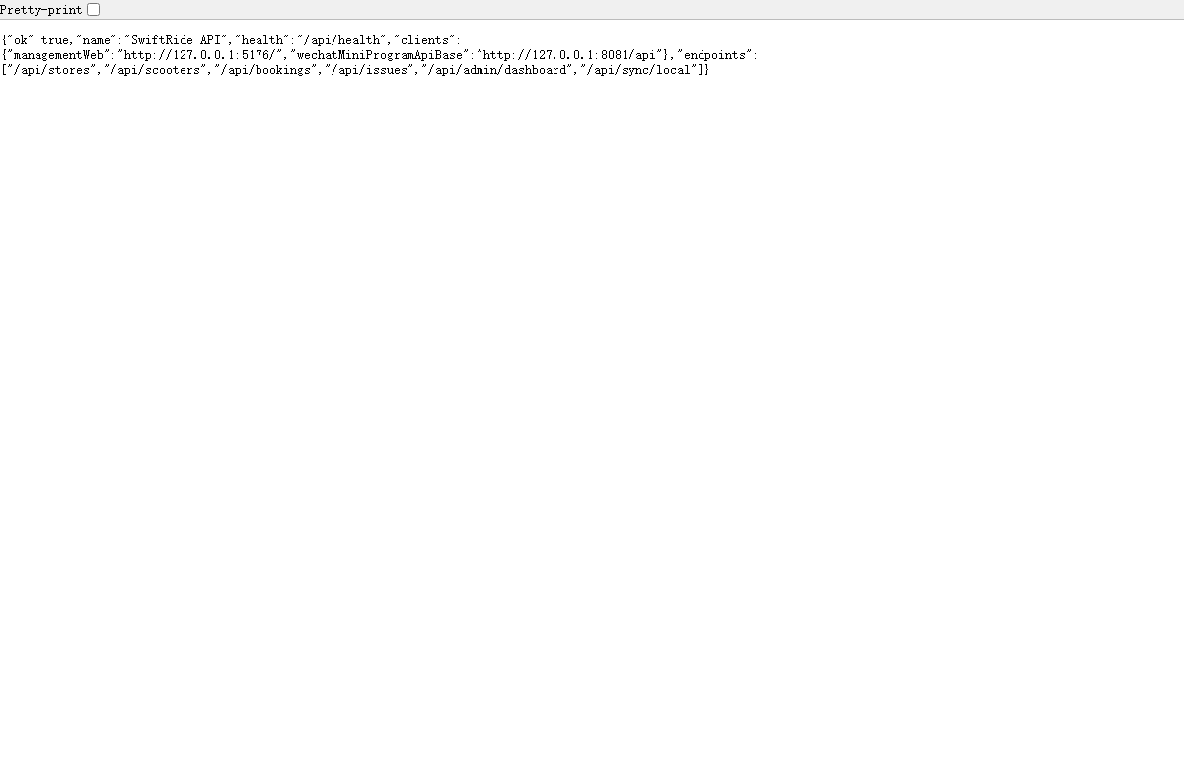
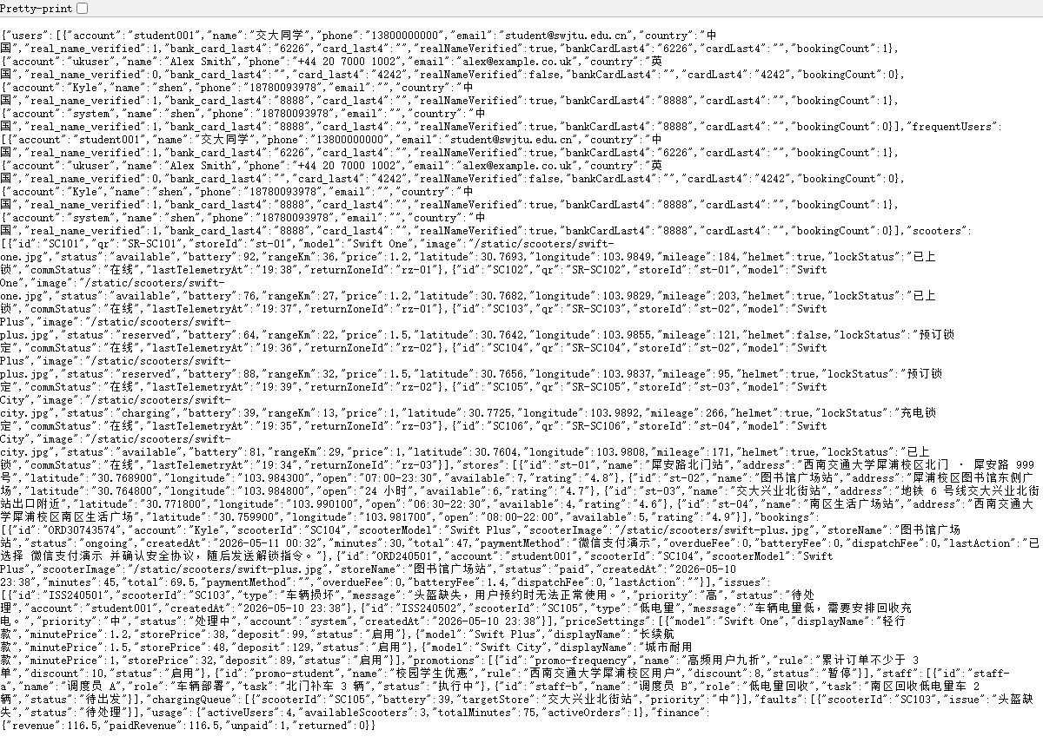
08
Testing Evidence
Testing Evidence
Build, API, UI, and integration checks
Test Item | Tool | Expected Result | Actual Result | Status
Backend health | Invoke-RestMethod / browser | API returns ok:true | Confirmed at /api/health | Passed
Management web build | Vite build | Production bundle generated | Build completed | Passed
Mini Program build | uni build -p mp-weixin | dist/build/mp-weixin generated | Build completed | Passed
Admin UI manual test | Playwright screenshot | Dashboard loads data from API | Metrics and tables visible | Passed
Database sync | POST /api/sync/local | local cache writes to MySQL | Endpoint implemented/tested | Passed
Evidence screenshots: API root, admin dashboard JSON, management web UI

Slide 11
09
Final Demo Flow
Final Demo Flow
Classroom-ready scenario
1
Select language
2
Login / Register
3
Browse scooters
4
Book and unlock
5
Return / report issue
6
Sync local data
7
Admin verification
Demo Script
Backup Demo Evidence
Open Mini Program from the package root.
Use student001 / 123456 for a prepared account.
Create or inspect an order, then open management web to verify backend data.
API root and dashboard endpoint screenshots.
Management web screenshots with live MySQL data.
Build commands already verified.

Slide 12
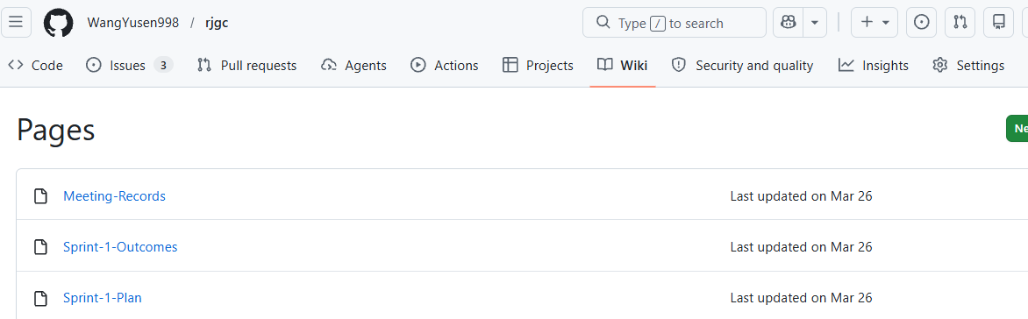
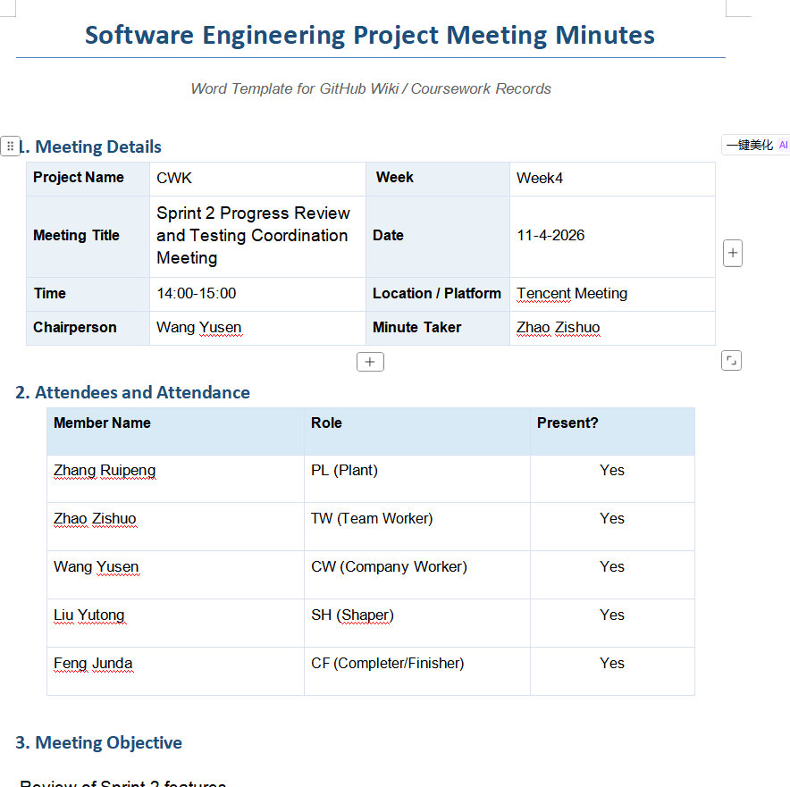
10
Process Management
Process Management
Planning, tracking, and package handoff
Sprint Planning
Split into customer Mini Program, backend API, and management web.
Wiki Screenshot
Insert GitHub Wiki / documentation evidence
Progress Tracking
Used file-based milestones: DB connection, API routes, sync endpoint, package build.
Meeting Records Screenshot
Insert meeting notes or chat summary
Wiki / Docs
README, README_PACKAGE, and docs/app-web-split-plan.md record setup and delivery.
Task Board
Add GitHub Projects/Kanban screenshot if used by the team.
Local evidence found: README files and split-plan doc. External GitHub/Wiki evidence was not included in the package.

Slide 13
11
Teamwork and Communication
Teamwork and Communication
Role division and collaboration model
Role | Main responsibility | Sprint 4 output
Customer UI owner | Mini Program pages, profile modules, build stability | Home, booking, profile, sync UI
Backend owner | Express routes, MySQL connection, API contracts | REST API, sync endpoint, SQL schema
Admin web owner | Management dashboard and API integration | Metrics, tables, status updates
QA / Integration owner | Run scripts, package handoff, demo flow | Build/test evidence and zip package
Communication
Short feedback loop through WeChat + shared package handoff; issues captured from runtime errors and console logs.
Conflict handling
Priority rule: keep the demo stable first, then polish UI and package structure.
Decision making
Chose Express + MySQL + Vite/uni-app because it fits coursework demo speed and inspectability.
Time management
Sprint 4 focused on integration, build fixes, screenshots, and final presentation evidence.

Slide 14
12
Challenges
Technical Challenges and Solutions
Problems solved during final integration
Challenge | Cause | Solution | Result
Frontend-backend integration | Mini Program had local cache and remote API paths | Added unified request layer and sync endpoint | User data can sync to MySQL
MySQL connection | Local dev machine needed database tooling | Added db:start and db:init scripts | Backend health check returns ok
Module loading in WeChat DevTools | Separate data/api module failed in build output | Moved API functions into stable mock module | Pages no longer require data/api.js
Package handoff | Partner imported root folder and app.json was missing | Added root project.config.json | Root folder imports correctly
UI layout for profile | Flat account fields were hard to scan | Rebuilt profile as modal modules | Cleaner account management flow
Sprint 4 emphasis: integration stability over feature sprawl

Slide 15
13
Project Summary
Project Summary
What the project achieved and what remains
Achieved
Working end-to-end SwiftRide prototype with Mini Program, backend API, MySQL, and management dashboard.
Limitations
No production HTTPS domain, no real scooter IoT device, limited automated UI coverage, GitHub evidence not packaged.
Sprint 4 completed
Database connection, local-data sync, admin web, packaging, build verification, and presentation evidence.
Future improvements
Deploy backend, add production auth rules, expand automated tests, connect real telemetry, polish GitHub/Wiki process evidence.
Learned
Full-stack integration requires stable contracts, clear setup scripts, and careful runtime debugging.
4
7
6+
Core modules
API groups
DB tables

Slide 16
Thank You
Final Deliverables
Editable final PPTX
Integrated source package
Runnable backend + management web
WeChat Mini Program build output
Screenshot and test evidence
Group 4 | Software Engineering Course | Team Members: SwiftRide Development Team
Q&A
Demo Ready

